Slide 1
Project Presentation
Martin Kvisvik Larsen

Slide 2
Project Description
The project is to perform classification on the “Indian Pines” dataset using one linear classifier and one non-linear classifier. Then the performance and model assumptions of the two classifiers shall be compared.
Linear method: PCA-LDA
Non-linear method: SVM

Slide 3
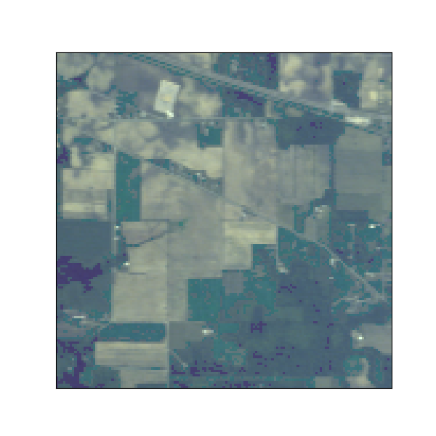
The “Indian Pines” dataset
Hyperspectral dataset collected in 1992 by Purdue University in Indiana, U.S.
Airborne AVIRIS hyperspectral imager
Agricultural area and forest
Spectral range: 400-2500 nm
Channels: 220
Number of classes: 17

Slide 4
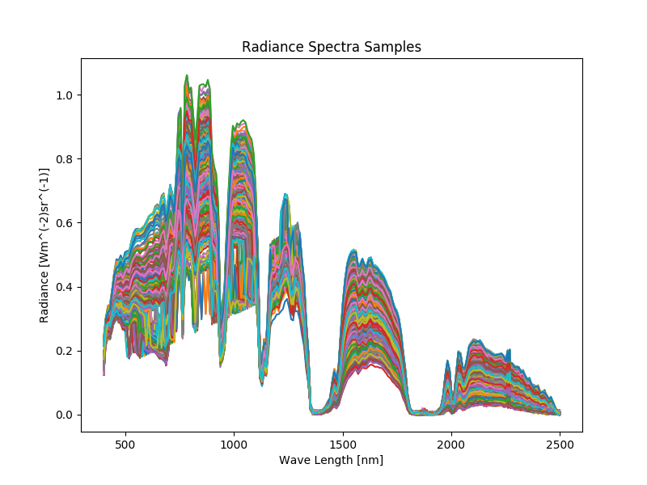
Data Inspection
Class Number | Class Name | # Samples
0 | Background | 10776
1 | Alfalfa | 46
2 | Corn-notill | 1428
3 | Corn-mintill | 830
4 | Corn | 237
5 | Grass-pasture | 483
6 | Grass-trees | 730
7 | Grass-pasture-mowed | 28
8 | Hay-windrowed | 478
9 | Oats | 20
10 | Soybean-notill | 972
11 | Soybean-mintill | 2455
12 | Soybean-clean | 593
13 | Wheat | 205
14 | Woods | 1265
15 | Buildings-Grass-Trees-Drives | 386
16 | Stone-Steel-Towers | 93

Slide 5
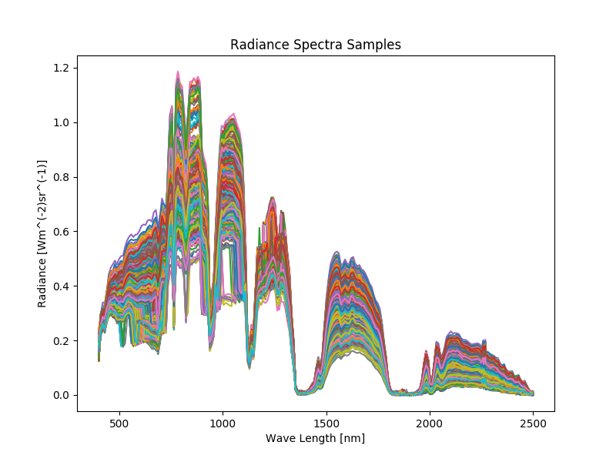
Resampling
Class Number | Class Name | # Samples
0 | Background | 80
1 | Alfalfa | 46
2 | Corn-notill | 80
3 | Corn-mintill | 80
4 | Corn | 80
5 | Grass-pasture | 80
6 | Grass-trees | 80
7 | Grass-pasture-mowed | 28
8 | Hay-windrowed | 80
9 | Oats | 20
10 | Soybean-notill | 80
11 | Soybean-mintill | 80
12 | Soybean-clean | 80
13 | Wheat | 80
14 | Woods | 80
15 | Buildings-Grass-Trees-Drives | 80
16 | Stone-Steel-Towers | 80

Slide 6
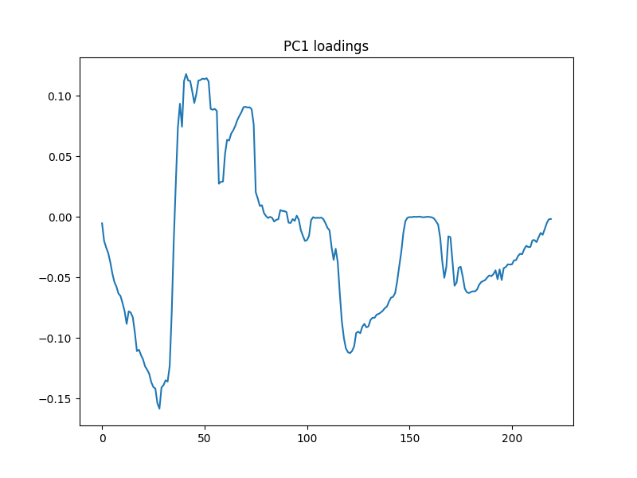
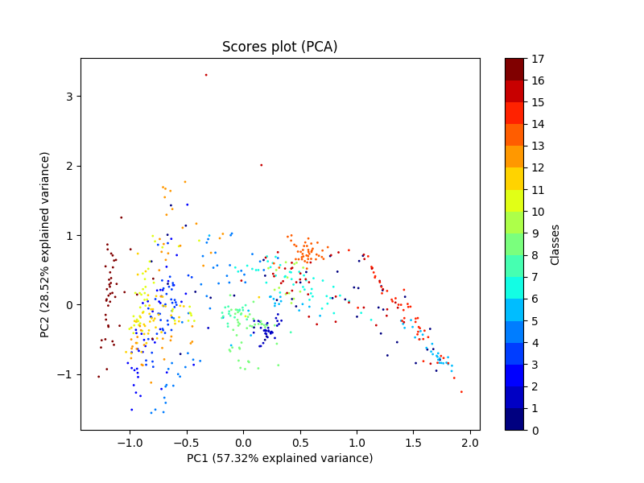
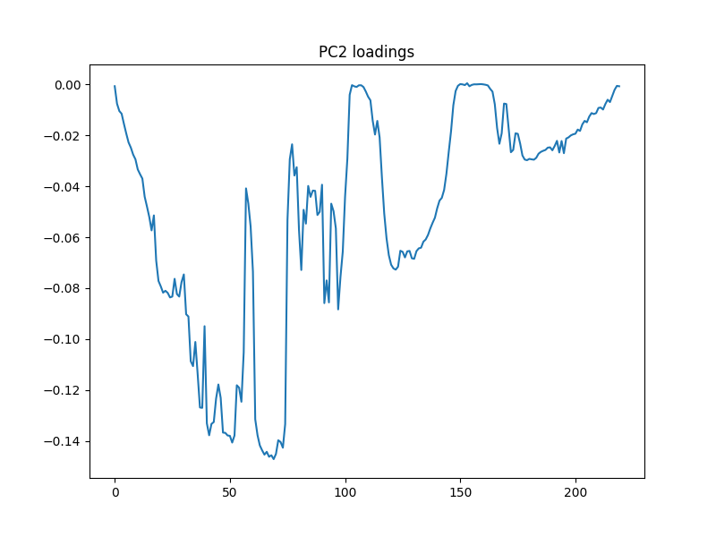
PCA Inspection on Raw Data

Slide 7
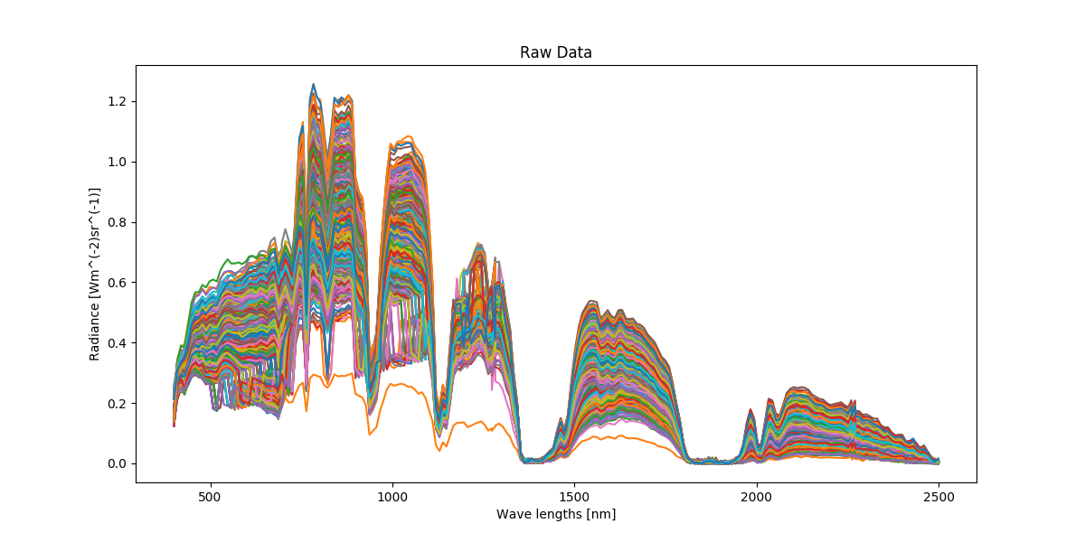
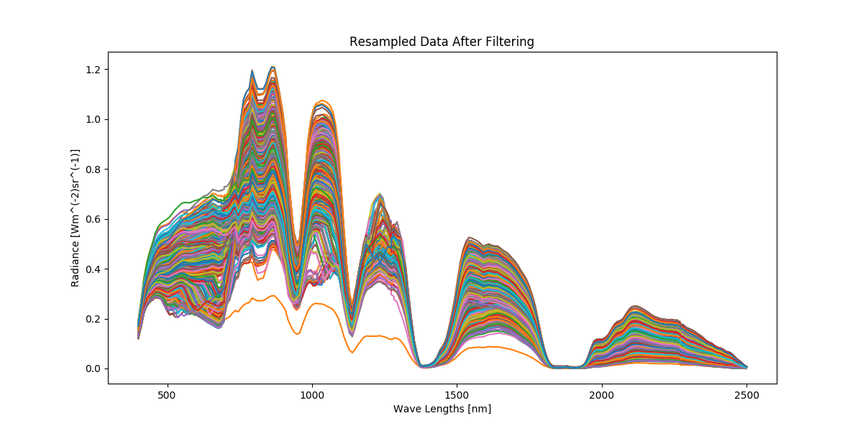
Sample preprocessing
Resampled Raw Data
Moving Average Filter

Slide 8
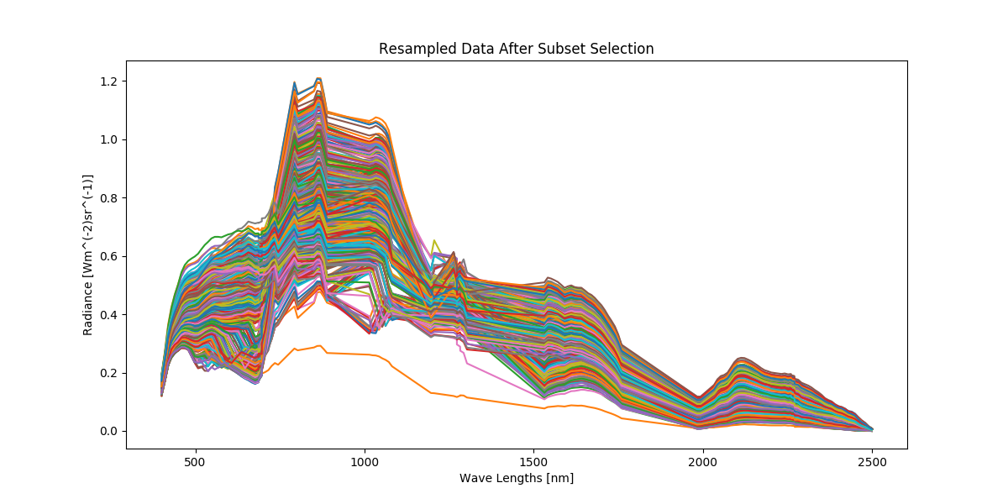
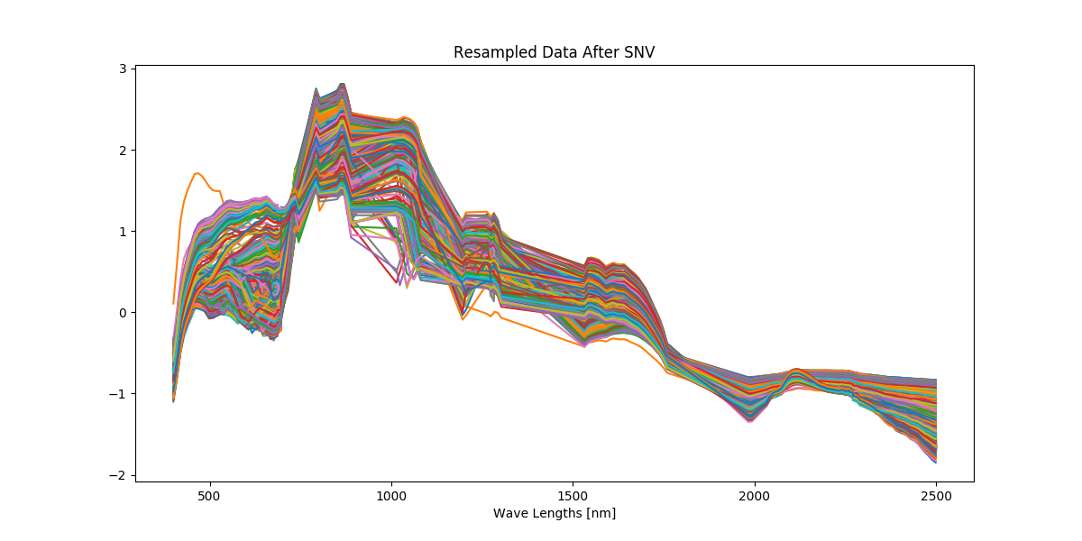
Sample preprocessing
Subset Selection
Standard Normal Variate (SNV)

Slide 9
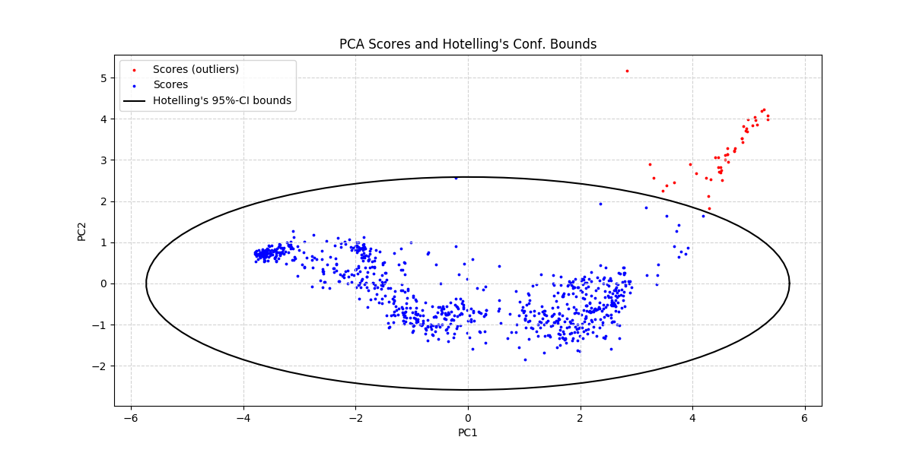
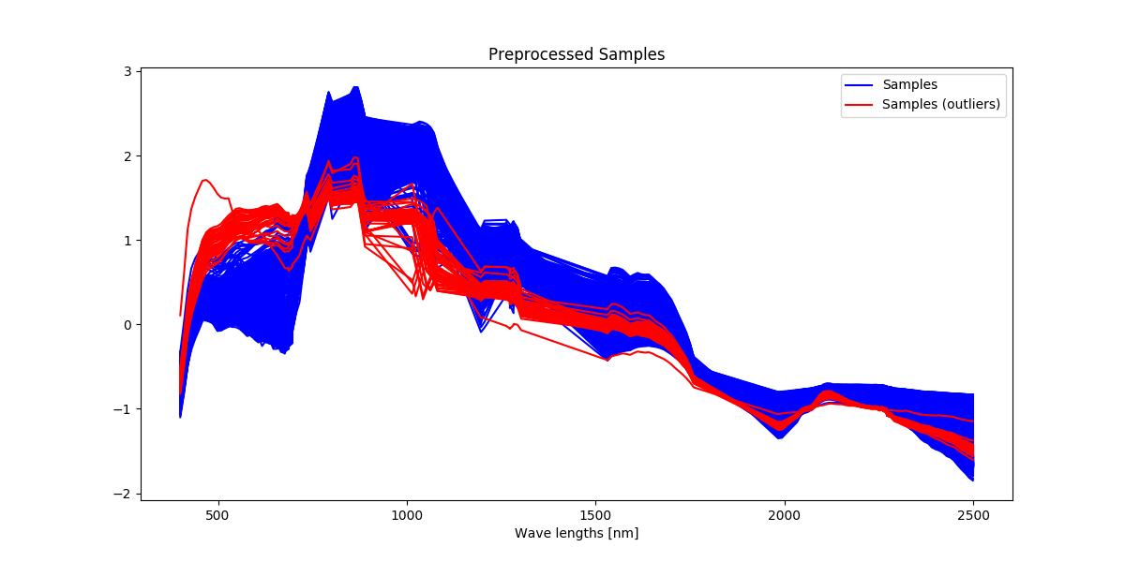
Outlier Detection
Hotelling’s T-squared test
Inspection of “outliers”

Slide 10
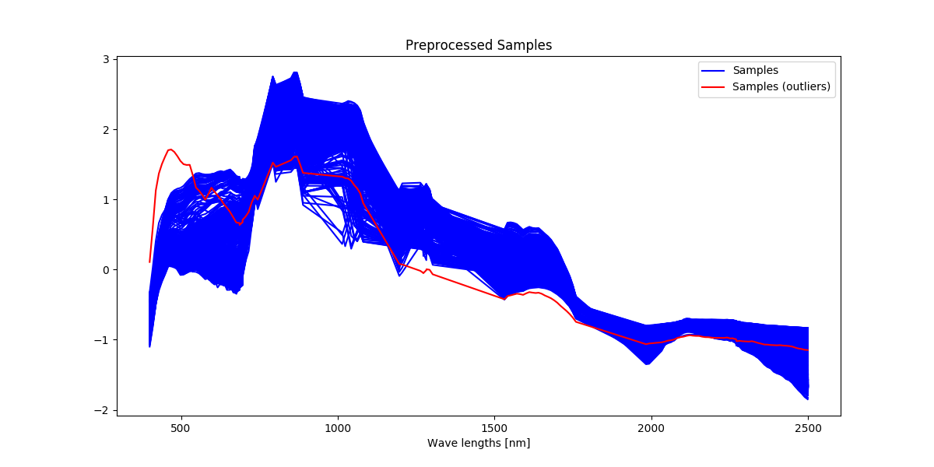
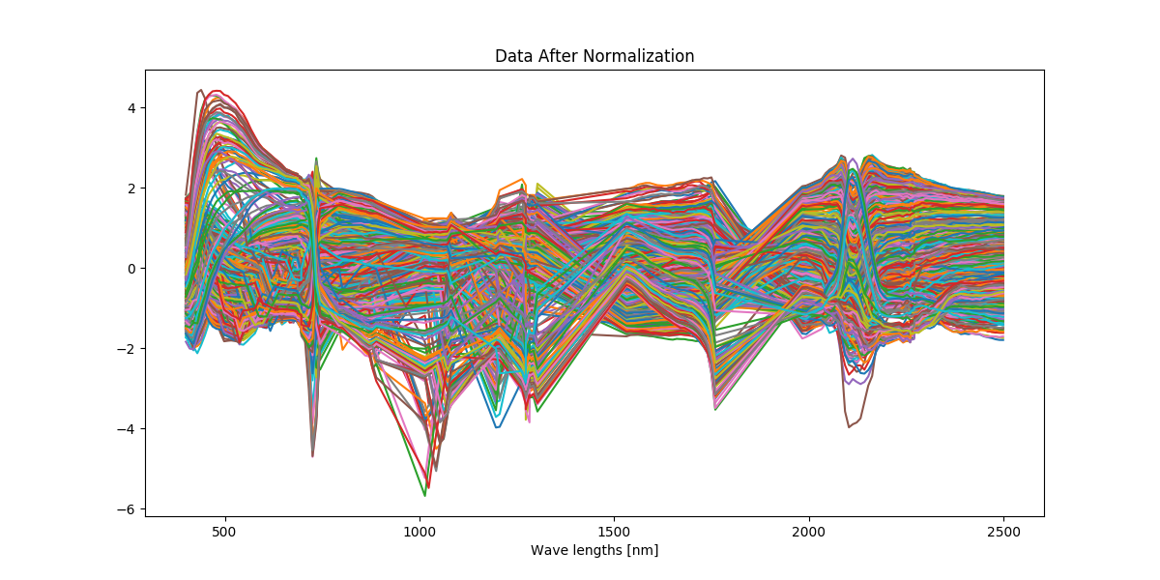
Outlier Removal and Normalization
Can really only justify removal of one of the “outliers”
Normalization

Slide 11
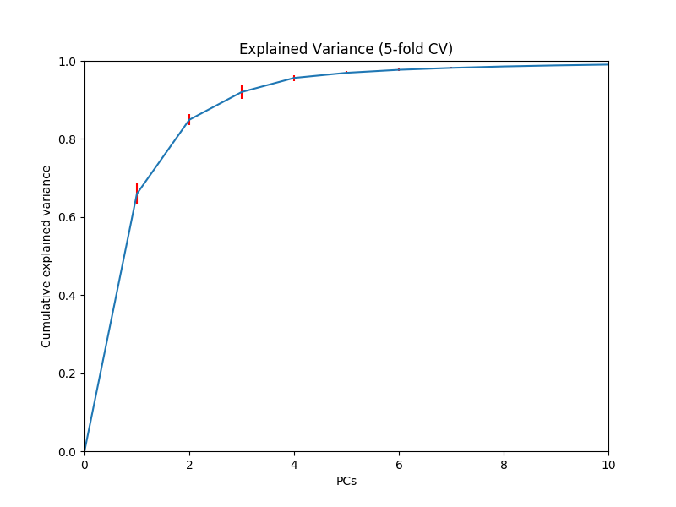
Linear Classification: PCA-LDA
PCA model selection
5-fold CV for selecting number of PCs
Explained variance threshold of 90%
LDA model selection
Parameter free - No CV

Slide 12
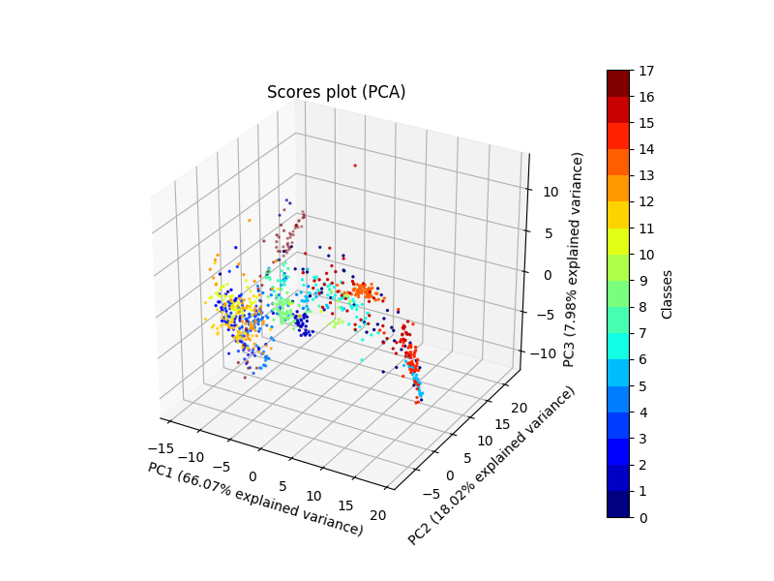
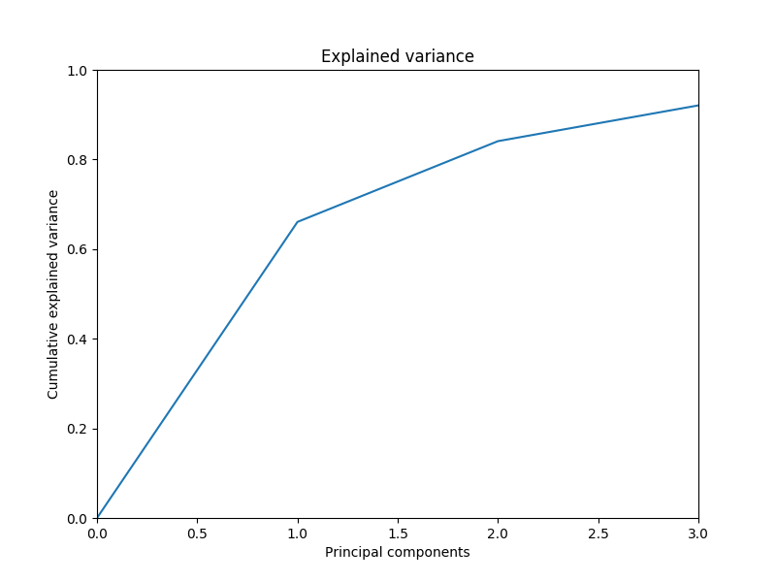
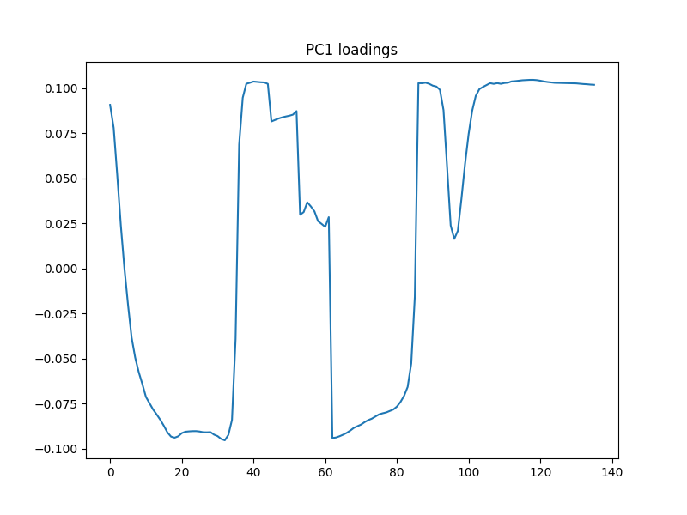
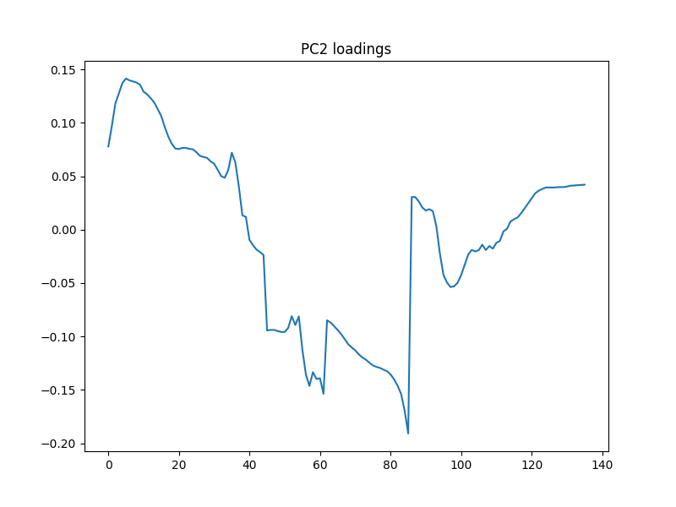
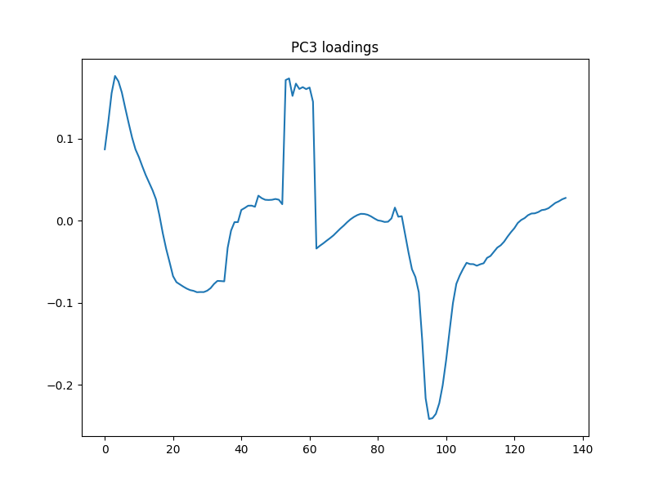
Linear Classification: PCA-LDA

Slide 13
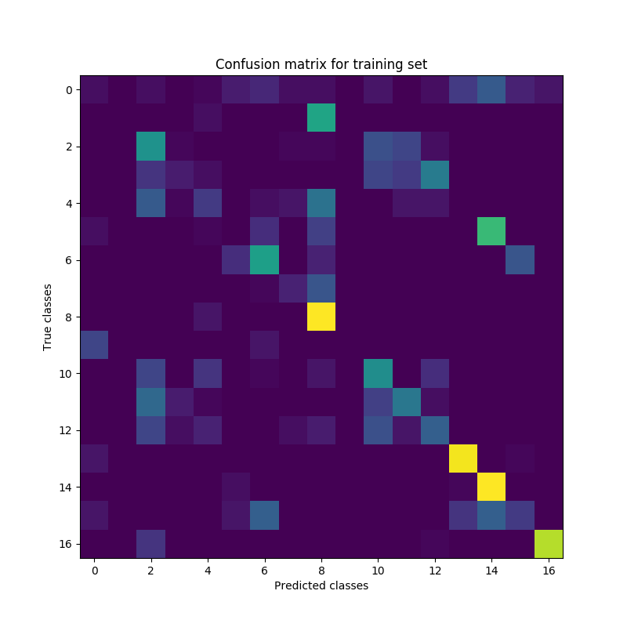
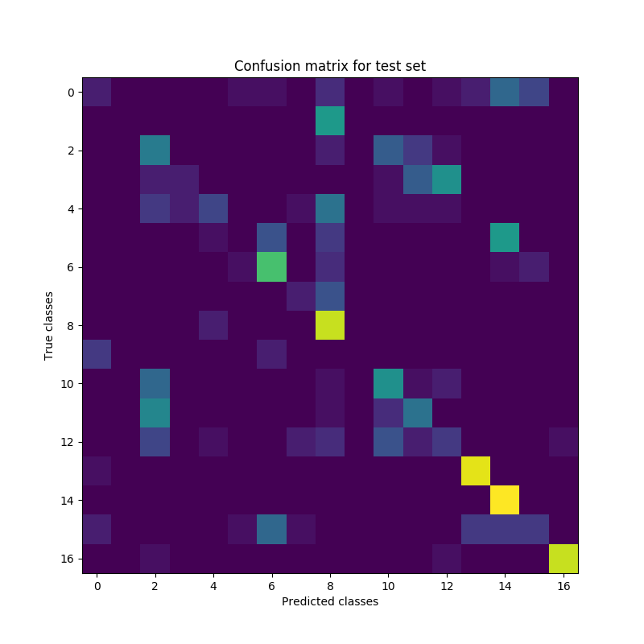
Linear Classification: PCA-LDA
Model assessment
Accuracy
Cross-entropy Loss
 | Training set | Test set
Accuracy | 41.65% | 43.53%
Mean cross-entropy loss | 1.8037 | 1.7077

Slide 14
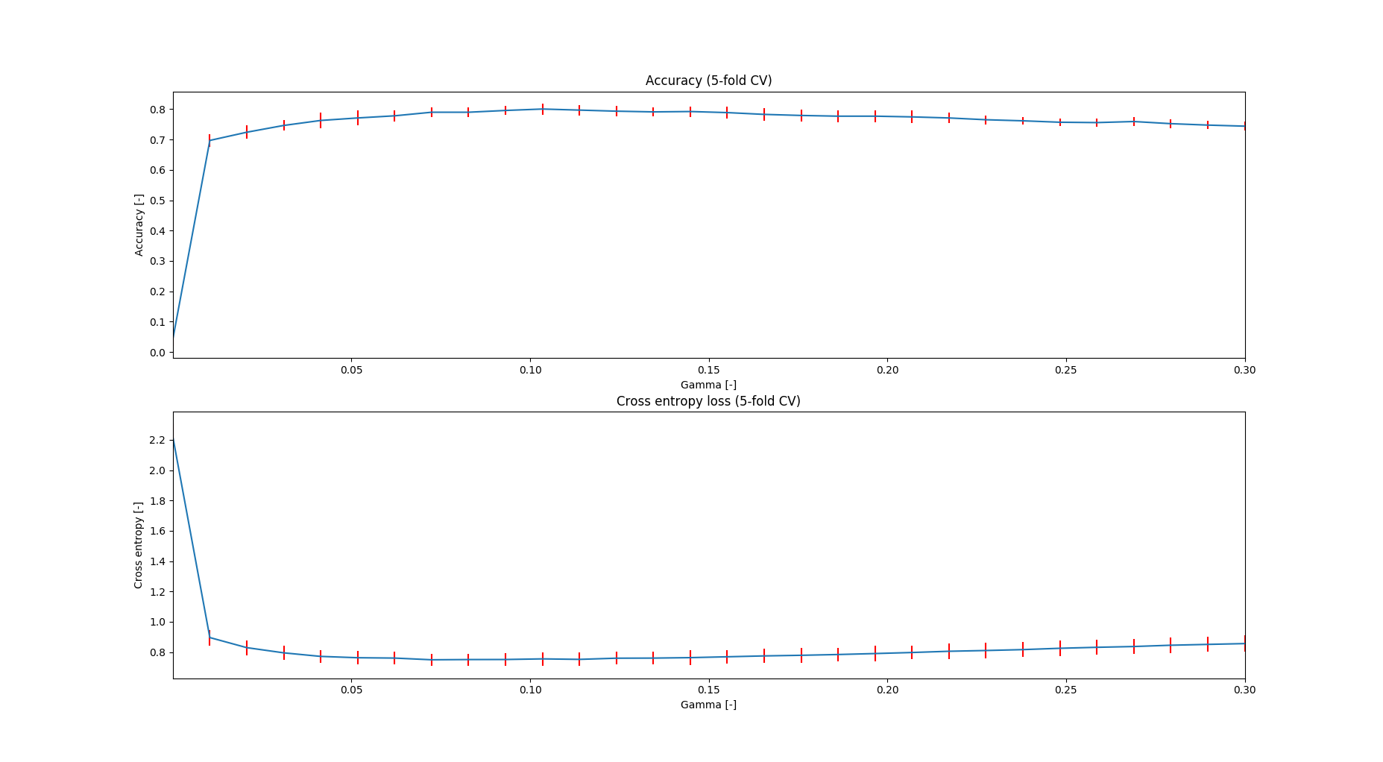
Nonlinear Classification: SVM
Model selection
5-fold cross validation for RBF kernel parameter, 𝛾
Minimum mean cross entropy loss
Best model
𝛾 ≅ 7.2×10^(-2)

Slide 15
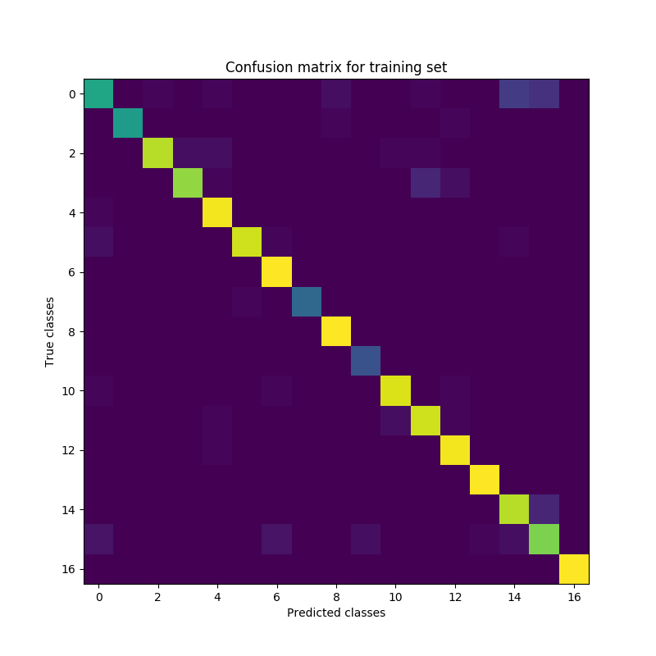
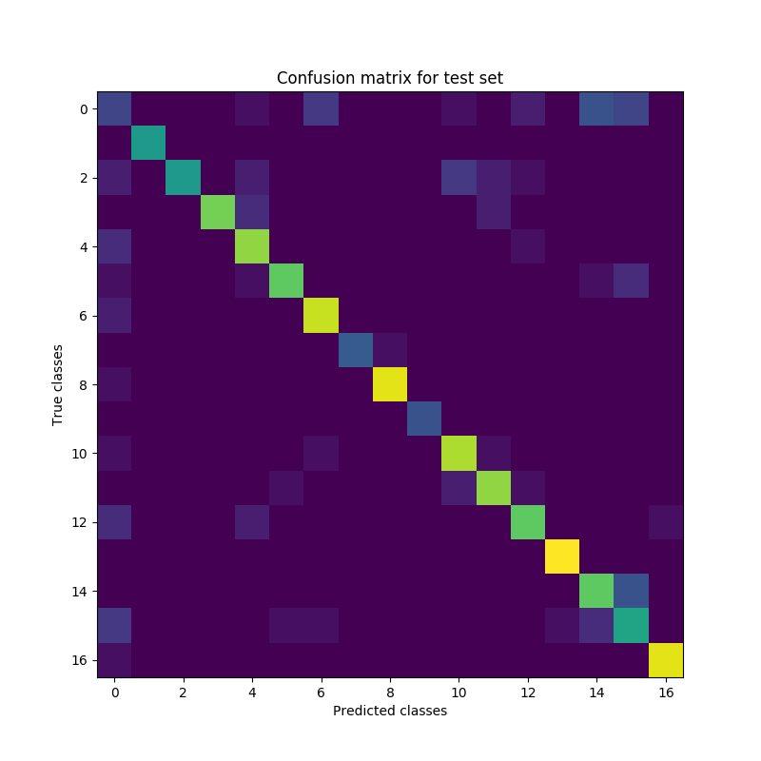
Nonlinear Classification: SVM
Model assessment
Accuracy
Cross-entropy Loss
 | Training set | Test set
Accuracy | 91.66% | 78.24%
Mean cross-entropy loss | 0.3679 | 0.6789

Slide 16
Classifier Comparison
Class Number | Class Name
0 | Background
1 | Alfalfa
2 | Corn-notill
3 | Corn-mintill
4 | Corn
5 | Grass-pasture
6 | Grass-trees
7 | Grass-pasture-mowed
8 | Hay-windrowed
9 | Oats
10 | Soybean-notill
11 | Soybean-mintill
12 | Soybean-clean
13 | Wheat
14 | Woods
15 | Buildings-Grass-Trees-Drives
16 | Stone-Steel-Towers

